Slide 1

Knights
SACHIN B
SHAHIN AHMED F
SABARISH T
SANJAY KUMAR V
SANJAY K
SYED MOHAMMED ALI S

Slide 2

LOG IN PAGE

Slide 3
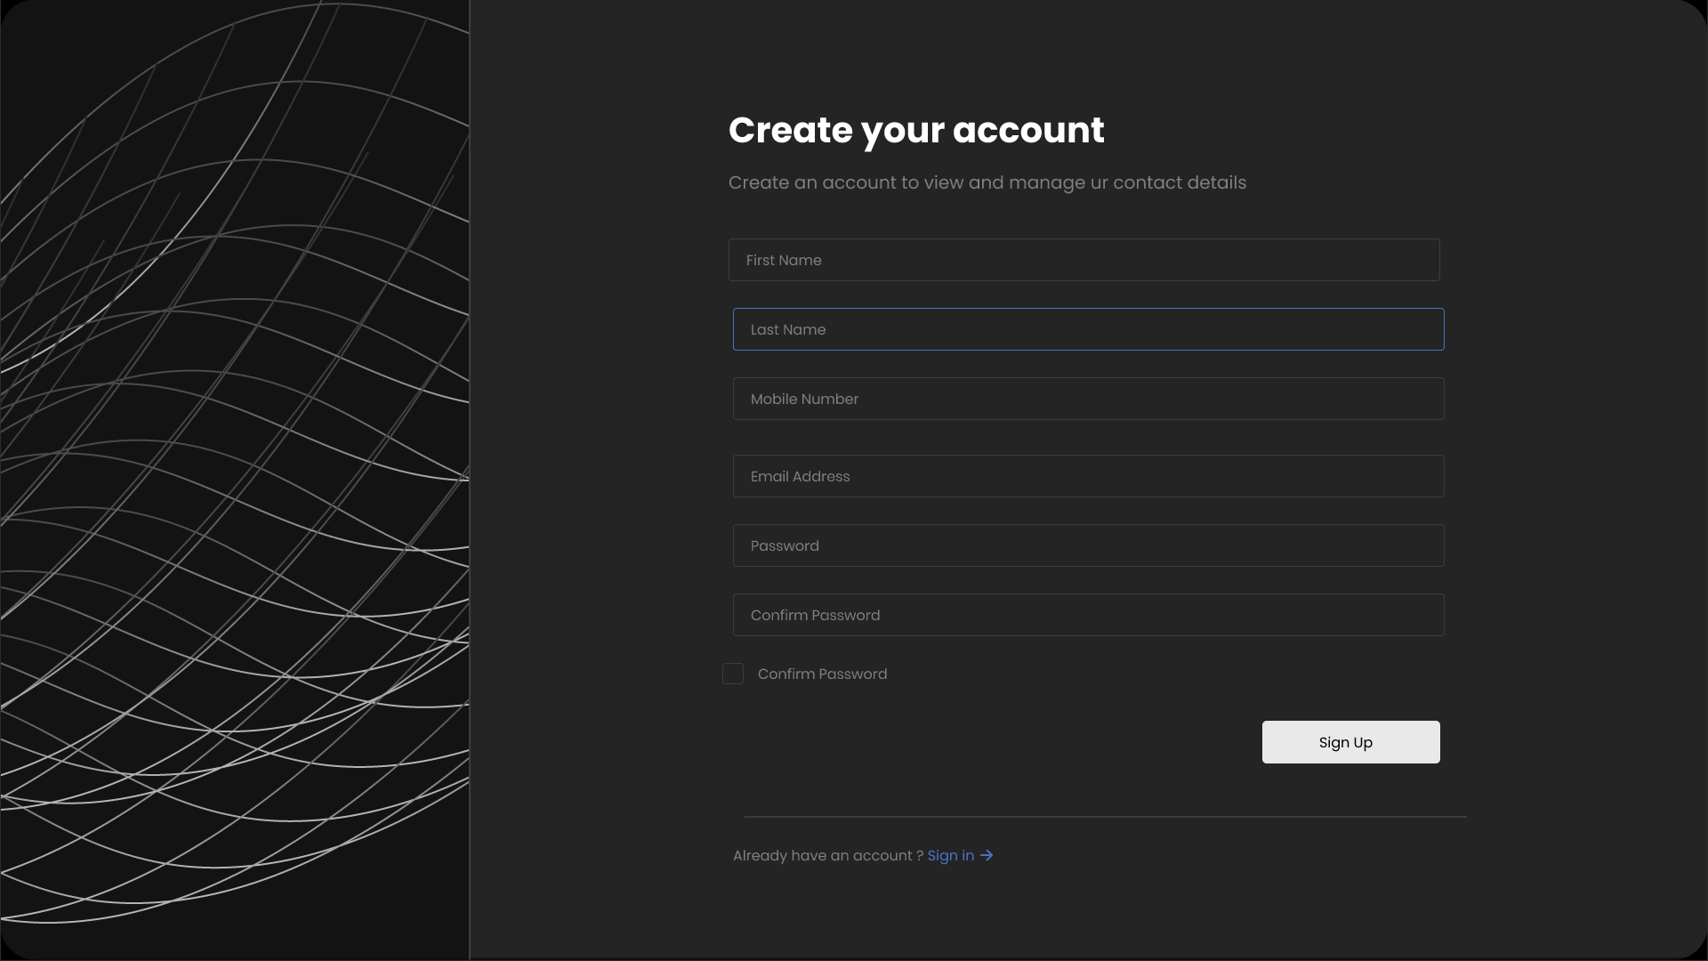
SIGN UP PAGE

Slide 4


Slide 5
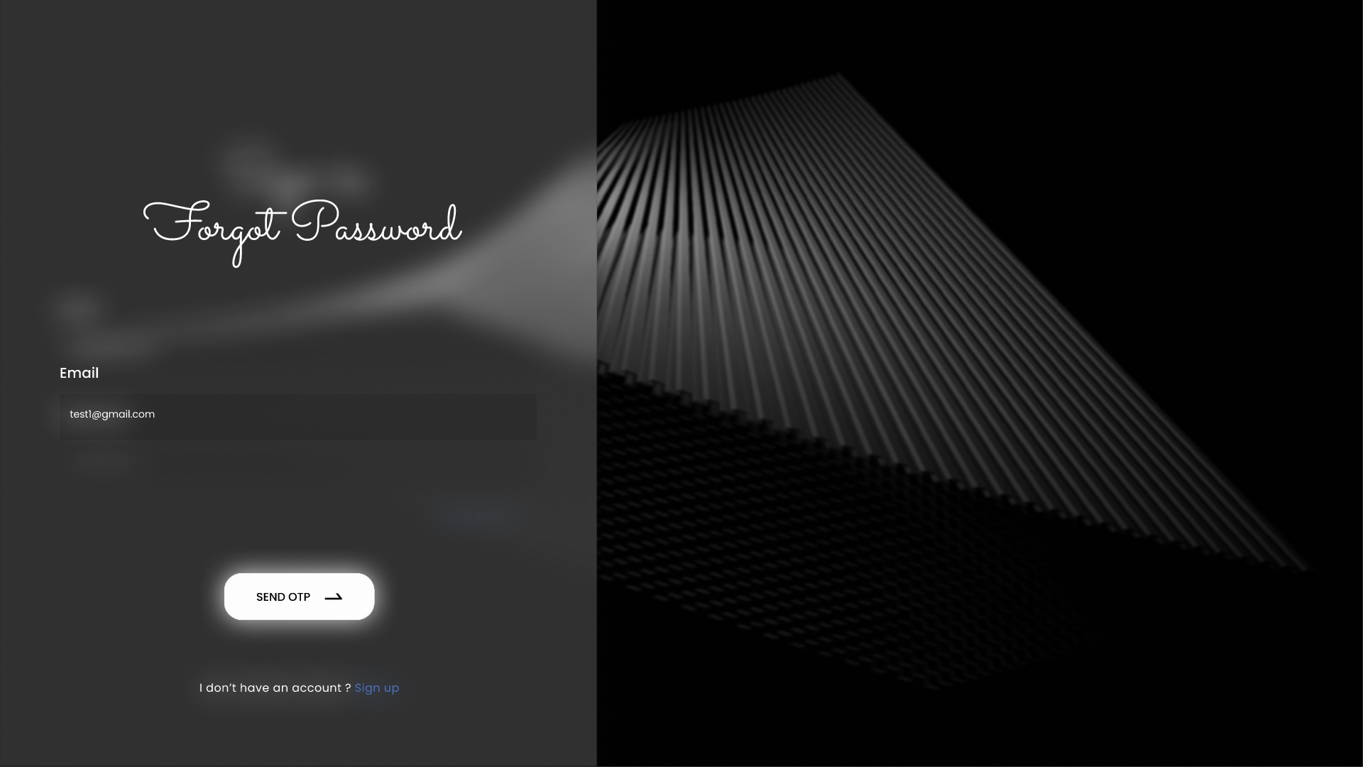
FORGOT PAGE

Slide 6
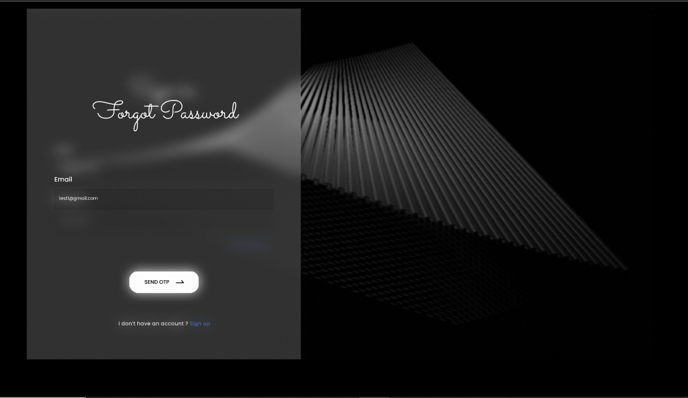

Slide 7
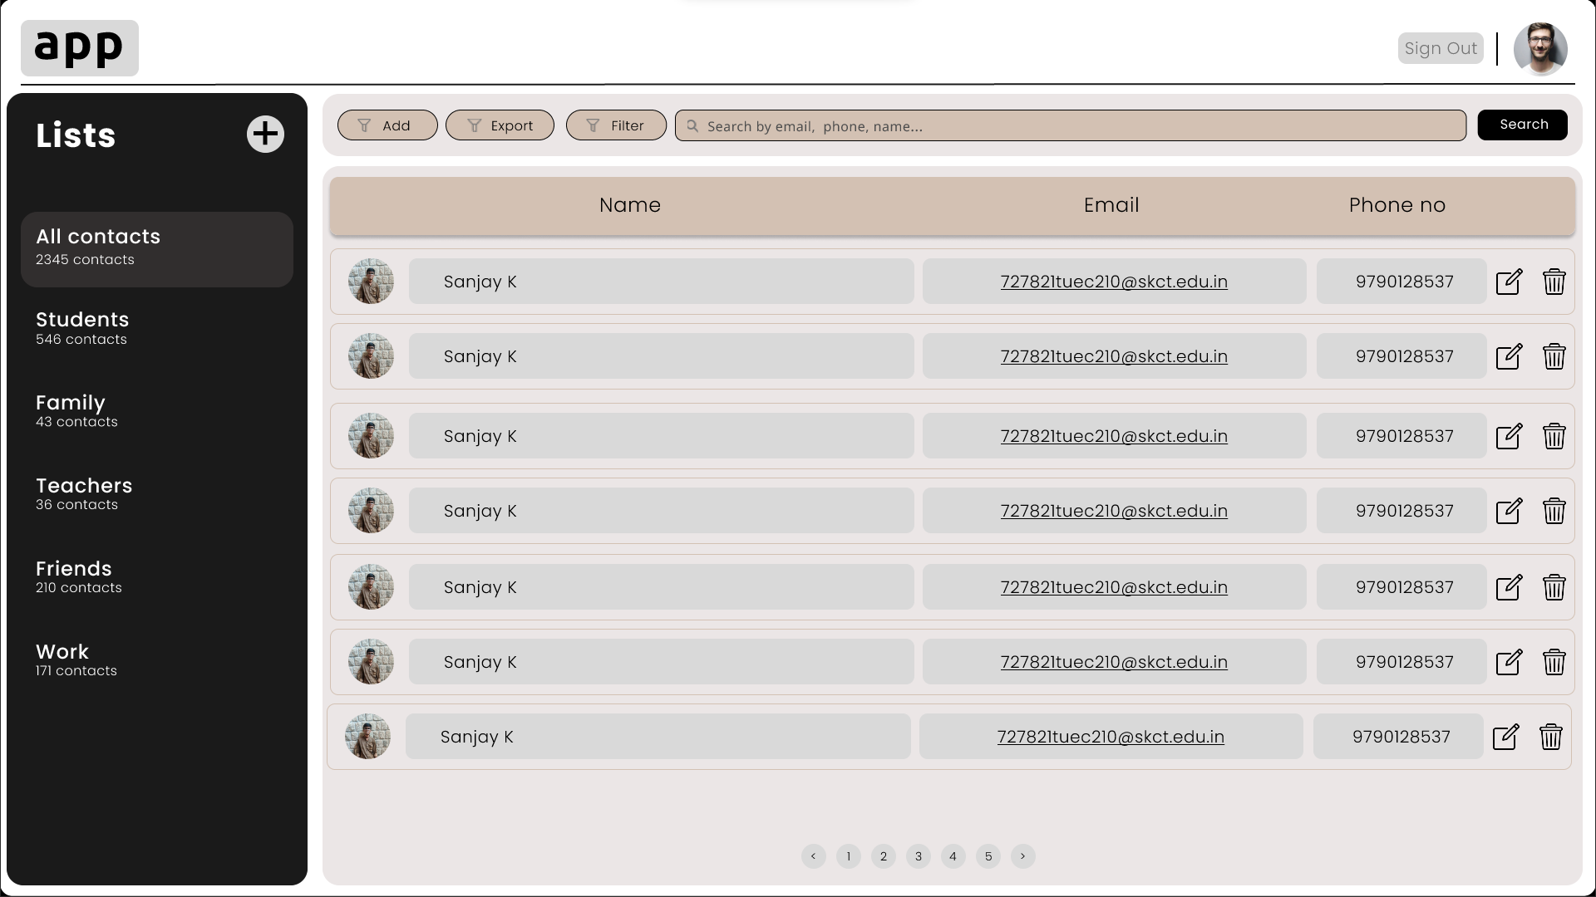
MAIN PAGE

Slide 8
GITHUB PROFILE LINK:
https://github.com/Sanjayk1004/Contact-manager

Slide 9


